Slide 1



2024
Z-stack: A High-performance DPDK-based
Zero-copy TCP/IP Protocol Stack
Anvaya B. Narappa† Federico Parola★ Shixiong Qi† K. K. Ramakrishnan†
†University of California, Riverside ★Politecnico di Torino
Visit us at:
https://kknetsyslab.cs.ucr.edu/

Slide 2
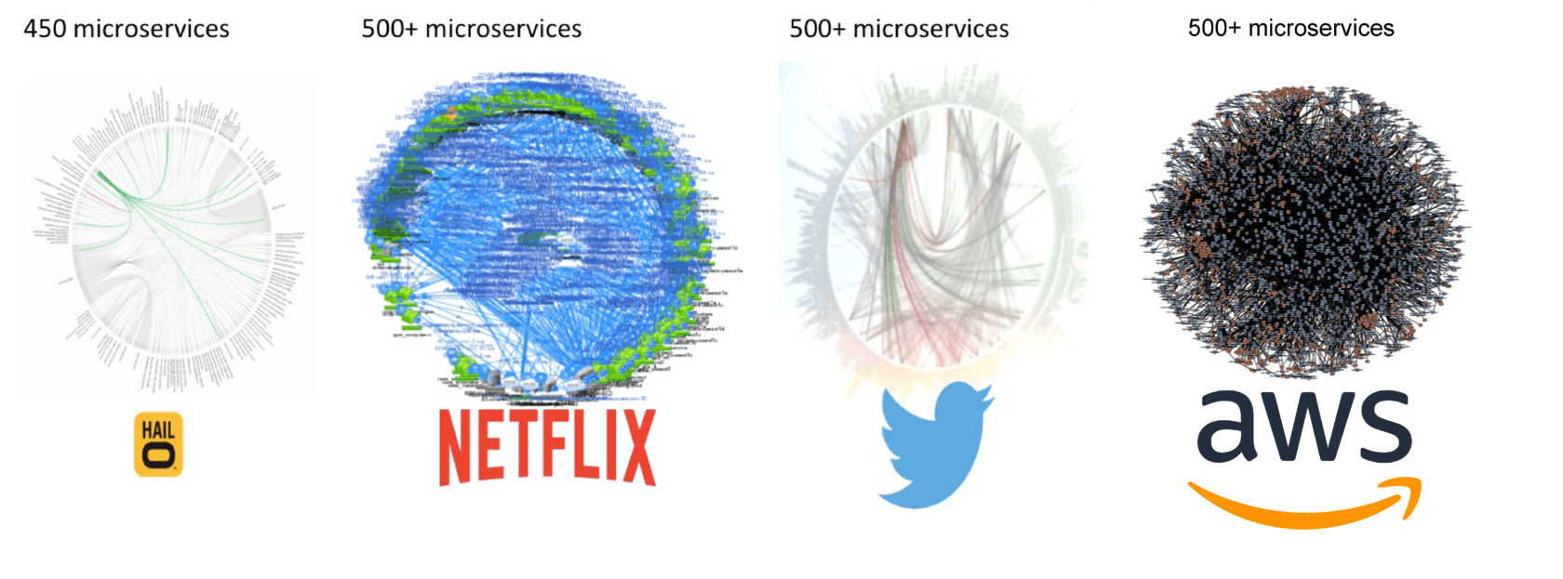
The Microservice Paradigm
Organize cloud-based applications with single-purpose, loosely-coupled microservices
Benefits: composable software design
  Independently deployable
  Easy to scale out
How to pass messages between microservices?
Requests
Ad Service
Frontend Service
Checkout Service
Payment Service
Recomm. Service
Email Service
Catalog Service
Cart Service
Shipping Service
Currency Service
Online Boutique Application from Google^{[1]}
[3, 4]
[2]
[3, 4]
[1] https://github.com/GoogleCloudPlatform/microservices-demo
[2] Decomposing Twitter: Adventures in Service-Oriented Architecture
[3] The Evolution of Microservices. https://www.slideshare.net/ adriancockcroft/evolution-of-microservices-craft-conference.
[4] Adrian Cockroft. Microservices Workshop: Why, what, and how to get there. http://www.slideshare.net/adriancockcroft/ microservices-workshop-craft-conference.

Slide 3
Data Center Networking
Data center networks have played a critical role in the Cloud over the past few decades
Many legacy cloud-based applications still depend on conventional Internet protocol stacks^{[1]}
  TCP-based congestion control (Layer 4)
  IP protocol (Layer 3)
  Ethernet (Layer 2)
Linux’s kernel TCP/IP networking stack has been robust and resilient through many decades of deployment and incremental evolution
[1] Gibson, Dan, et al. "Aquila: A unified, low-latency fabric for datacenter networks." NSDI 2022.

Slide 4

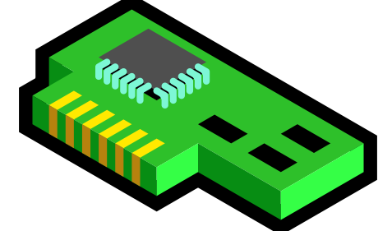
Basics of Kernel-based Networking
Inter-node example
Overheads
# of copies
# of context switches
# of interrupts (irqs)
# of proto. processing
# of serialization
# of deserialization
Overheads | Kernel networking (inter-node)
# of copies | 2
# of context switches | 2
# of interrupts (irqs) | 3
# of proto. processing | 2
# of serialization | 1
# of deserialization | 1
Node 1
Node 2
Userspace
Userspace
User application
User application
copy
ser.
deser.
copy
socket
socket
cxt sw
irq
irq
cxt sw
Kernel protocol stack
Kernel protocol stack
Kernel space
Kernel space
proto.
proto.
NIC
NIC
irq

Slide 5
Basics of Kernel-based Networking
Intra-node example
Overheads | Kernel networking (inter-node)
# of copies | 2
# of context switches | 2
# of interrupts (irqs) | 3
# of proto. processing | 2
# of serialization | 1
# of deserialization | 1
Overheads | Kernel networking (inter-node) | Kernel networking (intra-node)
# of copies | 2 | 2
# of context switches | 2 | 2
# of interrupts (irqs) | 3 | 2
# of proto. processing | 2 | 1
# of serialization | 1 | 1
# of deserialization | 1 | 1
Node 1
Userspace
User application
User application
copy
ser.
deser.
copy
socket
socket
cxt sw
irq
irq
cxt sw
Kernel protocol stack
Kernel space
proto.
NIC

Slide 6
DPDK-based User Space Packet Processing
Kernel-bypass networking
Data Plane Development Kit (DPDK) allows user space apps to directly access packet data
  NIC uses DMA to copy data into kernel user space buffer
  Interrupt use polling to find when packets arrive
  Copy packet data from kernel space to user space
  Use system regular function call to transmit packet from user space
Examples:
  F-stack^{[1]}, mTCP^{[2]}
Native Linux
DPDK
User Applications
User Applications
User
Space
Poll Mode Driver (PMD)
System calls
Kernel
Kernel
bypass
Interrupts
[1] https://github.com/F-Stack/f-stack
[2] Jeong et al. mTCP: a highly scalable user-level TCP stack for multicore systems." NSDI 14
NIC
NIC

Slide 7
Principle of Shared Memory Processing
Bypass the kernel
Overhead saving by shared memory processing
  Context switch, interrupt, copy, protocol processing, serialization/de-serialization
Pass by reference
Overheads | Kernel-based networking (intra-node) | Shared Memory Processing
# of copies | 2 | 0
# of context switches | 2 | 0
# of interrupts (irqs) | 2 | 2
# of proto. processing | 1 | 0
# of serialization | 1 | 0
# of deserialization | 1 | 0
Overheads | Kernel-based networking (intra-node) | Shared Memory Processing
# of copies | 2
# of context switches | 2
# of interrupts (irqs) | 2
# of proto. processing | 1
# of serialization | 1
# of deserialization | 1
Overheads | Kernel-based networking (intra-node) | Shared Memory Processing
# of copies | 2 | 0
# of context switches | 2 | 0
# of interrupts (irqs) | 2 | 0
# of proto. processing | 1 | 0
# of serialization | 1 | 0
# of deserialization | 1 | 0
Node 1
Shared Mem. Pool
polling
Userspace
Ref.
User application
User application
irq
irq
socket
socket
Kernel protocol stack
Kernel space
NIC

Slide 8
Shared Memory Processing is Being Widely Used
Serverless Computing
  SPRIGHT [SIGCOMM’22], Pheromone [NSDI’23], Ditto [SIGCOMM’23], Faasm [ATC’20]
Cellular Networks
  L25GC [SIGCOMM’22]
Middleboxes
  Microboxes [SIGCOMM’18], MiddleNet [NetSoft’22]
Network Function Virtualization
  Netmap [ATC’12], NetVM [NSDI’14], MiddleNet [NetSoft’22]
ML/AI
  Ray [OSDI’18], LIFL [MLSys’24]

Slide 9
Limitation of Shared Memory Processing
Tremendous improvements to the data center networking
But is limited to a single node
Can we maximize shared memory processing?
  Locality-aware Placement^{[1][2]}
Application deployments often have to hyperscale
  Not always realistic to apply locality-aware placement
With Locality-aware Placement
Without Locality-aware Placement
Client
Client
Client
Client
Client
Client
Client
Client
Worker Node 1
Worker Node 2
Worker Node 1
Worker Node 2
SHARED MEMORY
SHARED MEMORY
SHARED MEMORY
SHARED MEMORY
App.
App.
App.
App.
App.
App.
App.
App.
[1] Jin, Chao, et al. "Ditto: Efficient serverless analytics with elastic parallelism." SIGCOMM 2023.
[2] Qi, Shixiong , et al. "LIFL: A Lightweight, Event-driven Serverless Platform for Federated Learning." MLSys 2024.

Slide 10

Limitation of Shared Memory Processing
“Inter-node” communication still pervasively depends on protocol processing, e.g.,
  Middleboxes
    NAT, Firewalls, Load balancers, Caches
  Communication with external clients
    Still depend on protocols such as HTTP and TCP
Worker Node
Shared Mem. Pool
Frontend Gateway
App. 1
App. 2
HTTP response
Headers
Payload
Protocol Stack
Physical NIC
HTTP request
Headers
Payload
External client

Slide 11
Also: Chained Functionality in the Cloud
Cloud applications are often sequential
  Microservice chain, Serverless function chain, NFV chain, Middlebox chain, …
App 1
App 2
App 3
App 4
Shared Memory Pool
copy
copy
Protocol Stack
Data
Data
Need Zero-copy, High-performance Protocol Stack to seamlessly work with Intra-node Shared Memory Processing

Slide 12
Overview of Z-stack
A High-performance DPDK-based Zero-copy TCP/IP Protocol Stack
How to Eliminate Overheads of Kernel-based Protocol Stack?
How to Seamlessly Work with Intra-node Shared Memory Processing?
Data Copy I/O Overhead
Zero-copy I/O Calls
Userspace
Kernel User Overhead
User Space Protocol Processing
Interrupt
Overhead
Polling
Kernel

Slide 13
Interrupt-driven Packet Processing
Very distracting! Have to stop doing useful work to handle incoming packets
Coalescing interrupts helps, but still causes problems
  Interrupts can arrive during critical sections!
  Interrupts can be delivered to the wrong CPU core!
  Still must pay interrupt cost
App
Kernel
Kernel
App
App
Kernel
App

Slide 14
Polling-based Packet Processing in Z-stack
Continuously loop looking for new packet arrivals
Trade-off?
App
Busy wait
App
Polling can be wasteful
Kernel
App
App
Kernel
App
Interrupts help share the CPU

Slide 15
Kernel Bypass in Z-stack
User-space Driver
  Kernel only sets up basic access to NIC
    UIO driver
  User-space driver (PMD) tells NIC to DMA data directly into user-space memory
No in-kernel processing
No context switching
No kernel-userspace copies
User Space Driver
Memory (RAM)
2
Z-stack
User
Space
DPDK PMD
Packet Data
Descriptors
Kernel
Space
System Calls
Stack
UIO Driver
Descriptors
DMA
Configuration
1
Descriptor
Rings
CSRs
From Intel DPDK University Lecture
NIC
Notes:
Cover UIO driver

Slide 16
Zero-copy Socket APIs in Z-stack
Not only DMA into Userspace shared memory, also directly accessible to functions!
  Reference (“data pointer”) of shared memory data exposed by zero-copy APIs
Z-stack is very suitable for function chains
  Don't want to copy data multiple times between functions and protocol stack
App 1
App 2
App 3
App 4
Shared Memory Pool
Protocol Stack
Data
Data

Slide 17
Concurrent Connection Support in Z-stack
Support multiple user sessions in a server application
  each of which is distinguished by its own connection
The key is to bind distinct “sockets” to different connections
Distribute requests to different connections via IP 4-tuples lookup
  Responsibility of TCP/IP protocol processing
TCP/IP protocol processing
IP 4-tuples lookup

Slide 18
Hardware Offloading in Z-stack
Modern NICs typically support Hardware Offloading to accelerate TCP/IP processing
  TCP Segmentation Offload (TSO) and Large Receive Offload (LRO)
  TSO (LRO) allows the protocol stack to pass (receive) a large buffer as a single unit to (from) the NIC
  The NIC takes care of (de)segmenting this large buffer into (from) smaller MTU-sized packets
Z-stack relies on the NIC’s TSO and LRO capability to handle the segmentation/de-segmentation of large messages
Reduce CPU utilization and improves overall system performance
Without Segmentation Offload
With Segmentation Offload
App
MTU * 4 data
App
MTU * 4 data
Application
Softwarized protocol stack
TCP
TCP
IP
IP
Physical
Net Device
Net Device

Slide 19
Evaluation
Experiment Setup
Alternatives
Z-stack vs. F-stack^{[1]} vs. Linux kernel protocol stack
F-stack is a DPDK-based TCP/IP stack without zero-copy capability
Testbed
  Two nodes on Cloudlab^{[2]}
  100Gbps NIC
  Ubuntu 22.04 with kernel 5.15
Workload:
  An echo server application
  Client: wrk^{[3]} - HTTP request generation tool
  Deployed on different nodes
Node 1
Node 2
Echo Server
Wrk client
Protocol stack
Protocol stack
NIC
NIC
[1] https://github.com/F-Stack/f-stack
[2] Duplyakin, Dmitry, et al. "The design and operation of {CloudLab}." 2019 USENIX annual technical conference (USENIX ATC 19). 2019.
[3] https://github.com/wg/wrk

Slide 20
Evaluation
zs: Z-stack fs: F-stack ks: Kernel Stack
Throughput performance
1 KBytes
4 KBytes
8 KBytes
64 Bytes
Small messages (64Bytes, 1KBytes)
  Z-stack has close throughput and latency performance compared to F-stack
    The data copy is not the dominant networking overhead when message sizes are small
  Up to 5× improvement (both throughput and latency) over Kernel Stack
Larger messages (4KBytes and 8KBytes)
  Z-stack achieves ∼2× throughput and latency improvement over F-stack
  Z-stack achieves up to 4× throughput and latency improvement when compared against Kernel Stack

Slide 21
Evaluation
zs: Z-stack fs: F-stack ks: Kernel Stack
Latency performance
1 KBytes
4 KBytes
8 KBytes
64 Bytes
Small messages (64Bytes, 1KBytes)
  Z-stack has close throughput and latency performance compared to F-stack
    The data copy is not the dominant networking overhead when message sizes are small
  Up to 5× improvement (both throughput and latency) over Kernel Stack
Larger messages (4KBytes and 8KBytes)
  Z-stack achieves ∼2× throughput and latency improvement over F-stack
  Z-stack achieves up to 4× throughput and latency improvement when compared against Kernel Stack
Notes:
Scale of y-axis

Slide 22
Evaluation
CPU Overhead
Under Light Loads: 60K
  CPU utilization for the Kernel Stack is 76%
  Z-stack’s CPU utilization is at 100% due to DPDK’s PMD
Under Heavy Loads: 120K, 200K, 290K
  Kernel Stack is inefficient
    Caused by its interrupt-based packet handling
  Z-stack’s CPU utilization is still 100%
Multiple applications can share Z-stack to amortize the polling overhead
  *Measured with kernel 5.15
(others)
(interrupts)
Z-stack’s polling approach proves to be more efficient for even slightly heavier traffic loads

Slide 23


Conclusion
Z-stack is a high-performance userspace TCP/IP protocol stack
  Offer true zero-copy data movement between the user application and NIC
    Yield overall a 2× throughput and latency improvement when handling large messages
    Compared to F-stack
  DPDK’s poll mode driver to eliminate context switches and interrupts
    Increase throughput and reduces latency up to a factor of 5
    Compared to kernel stack
  Seamlessly work with intra-node shared memory processing
Z-stack is open-sourced
  ☞ Find Z-stack at: https://github.com/anvayabn/Z-stack.git
  If you have any questions or comments, please feel free to email us (an001@ucr.edu, federico.parola@polito.it and sqi009@ucr.edu)
Paper:
Code:

