Slide 1
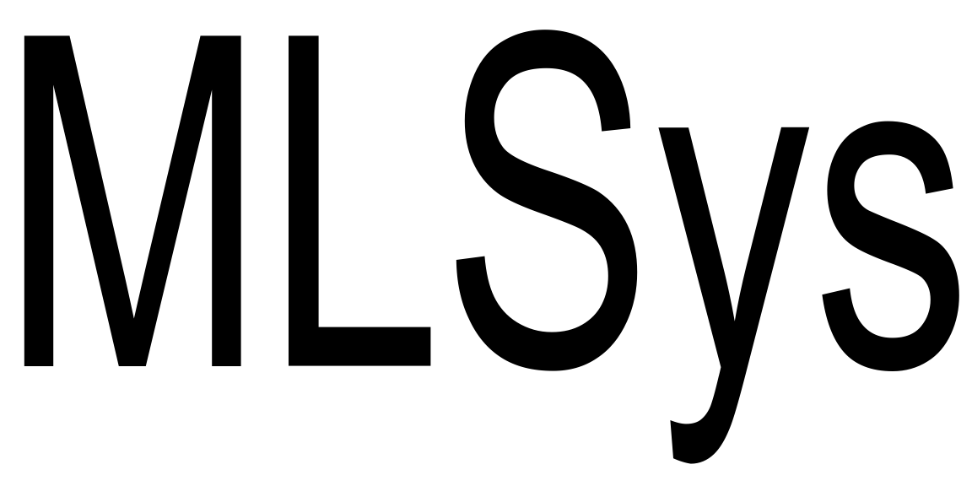
24
LIFL: A Lightweight, Event-driven Serverless Platform for Federated Learning
Shixiong Qi† K. K. Ramakrishnan† Myungjin Lee★
†University of California, Riverside ★Cisco Research
Visit us at:
https://kknetsyslab.cs.ucr.edu/
https://research.cisco.com/

Slide 2
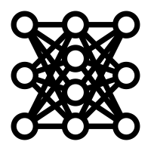
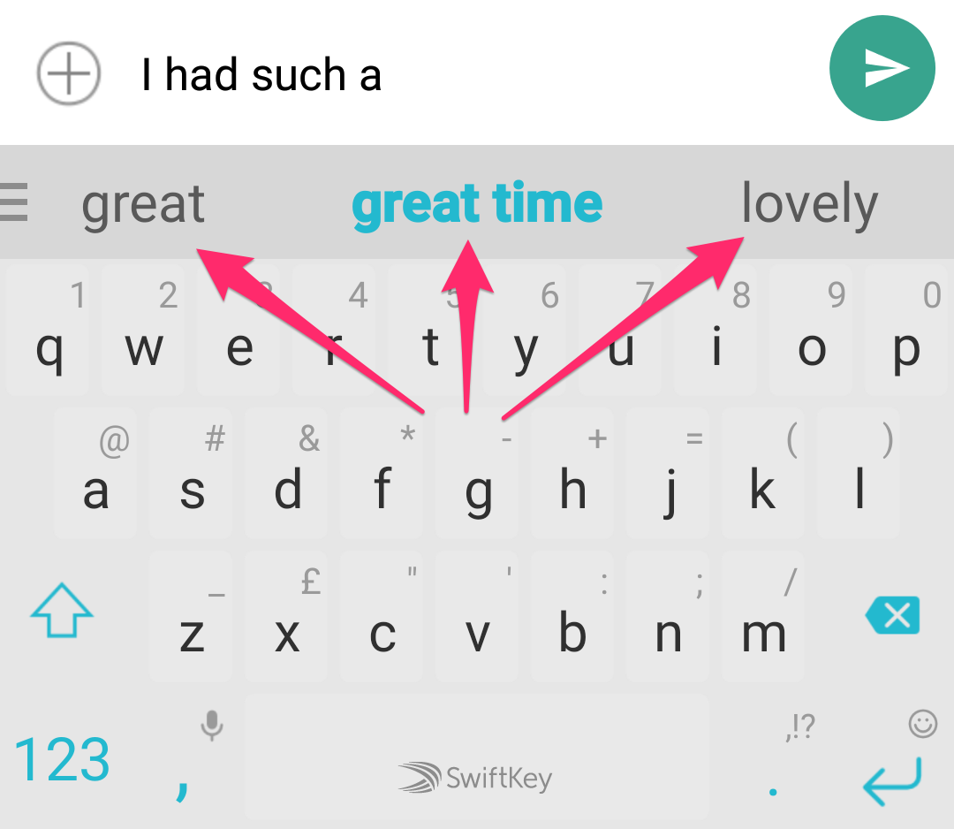
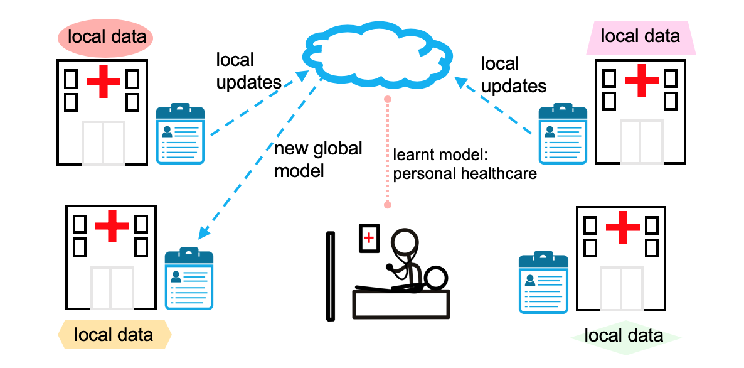
A Quick Primer on Federated Learning
Federated Learning (FL) helps
Learn on fresh real-world data
Reduce data privacy leakage
Execution of FL
Client selection
On-device Training
Model Aggregation
Federated Learning Platform
in the Cloud
Model Aggregation Server
(3) Model Aggregation
(1) Client selection
Keyboard prediction
Healthcare
Client
Client
Client
Client
Client
Client
Client
Client
Client
Client
Client
Client
(2) On-device Training

Slide 3
Existing System Design for Federated Learning
Model aggregation server (based on various commercial^{[1,2]} and open-source^{[3]} platforms)
Coordinator:
Orchestrating interactions among aggregators, selectors, and clients
Aggregator:
Hierarchical aggregation
Selector:
Selecting clients to participate in the FL process
Client-aggregator mapping
Use Cloud to scale FL training to many clients
Federated Learning Platform
Coordinator
Top Aggregator
Middle Aggregator
Middle Aggregator
Leaf Aggregator
Leaf Aggregator
Leaf Aggregator
Leaf Aggregator
Selector
Client
Client
Client
Client
Client
Client
Client
[1] Bonawitz, Keith, et al. "Towards federated learning at scale: System design." MLsys 2019.
[2] Huba, Dzmitry, et al. "Papaya: Practical, private, and scalable federated learning." MLsys 2022.
[3] Daga, Harshit, et al. “Flame: Simplifying Topology Extension in Federated Learning.” ACM SoCC’23.

Slide 4
Existing System Design for Federated Learning
Problem statement
High variability of # of FL clients
Real-world trace from GBoard^{[1]}
Serverful FL systems lack elasticity
[1] Bonawitz, Keith, et al. "Towards federated learning at scale: System design." MLsys 2019.

Slide 5
A “Serverless” Cloud for Federated Learning
Basics of Serverless Computing
“Event-driven” Execution: Applications are triggered based on events, terminated upon event completion
Fine-grained resource elasticity
True “Pay-as-you-go” Billing: Pay only for the duration of execution of an application. No charge when the application is idle
Fine-grained billing

Slide 6
A “Serverless” Cloud for Federated Learning
An abstract functional view
Serverless function is short-lived and stateless
Following the lifecycle of the event
Implication: Serverless function cannot perform “stateful processing”
Scale functions based on load
Control plane
Aggregator
Placement engine
Autoscaler
Find a node for placing a function
Aggregator
Aggregator
Metrics collection
Node 1
Node 2
Function
Message Broker
Function
Aggregator
Aggregator
Aggregator
Aggregator
Sidecar container
Sidecar container
Aggregator
Inter-function networking
Aggregator
Based on Knative
Requests

Slide 7
A “Serverless” Cloud for FL
Event-driven model aggregation
Existing serverless FL systems^{[1,2]} offer elasticity, but data plane is heavyweight^{[3]}
+① Kernel-based networking
+② Container-based sidecar
+③ Message broker
Control plane is suboptimal
Primary designed for web applications
Unable to support efficient FL aggregation
[1] Jayaram, K. R., et al. "Just-in-Time Aggregation for Federated Learning." IEEE MASCOTS 2022.
[2] Grafberger, Andreas, et al. "Fedless: Secure and scalable federated learning using serverless computing." IEEE Big Data 2021.
[3] Qi, Shixiong, et al. "SPRIGHT: extracting the server from serverless computing! high-performance eBPF-based event-driven, shared-memory processing." ACM SIGCOMM 2022.

Slide 8
LIFL: Lightweight FL with an optimized serverless design
Two primary focus in LIFL
Federated Learning System (Serverless)
Federated Learning System (Serverful)
Streamline the serverless data plane
Use eBPF to offload sidecar and message broker
Use shared memory processing to speed up hierarchical aggregation
Control plane optimization
Locality-aware placement
Hierarchy-aware scaling
Aggregator reusing
Eager aggregation
Federated Learning System (LIFL)
Serverless Control Plane
Serverless Control Plane
Coordinator
Coordinator
Coordinator
Message broker
Aggregator
Shared Mem. Pool
Aggregator
Aggregator
eBPF Sidecar
Sidecar
eBPF map
Aggregator
Aggregator
Aggregator
Aggregator
Aggregator
Aggregator
eBPF Sidecar
eBPF Sidecar
Sidecar
Sidecar
Aggregator
Aggregator
Aggregator
Aggregator
Aggregator
Aggregator
Aggregator
Aggregator
Aggregator
Aggregator
Aggregator
Aggregator
eBPF Sidecar
eBPF Sidecar
eBPF Sidecar
eBPF Sidecar
Sidecar
Sidecar
Sidecar
Sidecar
Selector
Selector
Selector
Client
Client
Client
Client
Client
Client
Client
Client
Client
Client
Client
Client
Client
Client
Client
Client
Client
Client
Client
Client
Client

Slide 9
Data Plane Optimizations in LIFL
+① eBPF-based stateful processing
eBPF: a code snippet attached to a specific “hookpoint” in the kernel
eBPF supports event-driven execution
NO cost when idle
eBPF’s stateful processing
In-kernel eBPF map
Metrics collection, Routing between aggregators
Aggregator
Message Broker
Aggregator
eBPF Sidecar
Sidecar Container
eBPF Sidecar
Sidecar Container
Kernel protocol stack
eBPF map

Slide 10
Data Plane Optimizations in LIFL
+② Shared memory processing for hierarchical aggregation
Bypass the kernel
Overhead saving by shared memory processing
Context switch, interrupt, copy, protocol processing, serialization/de-serialization
Pass by reference
Shared Memory Processing
Shared Mem. Pool
data
Aggregator
Aggregator
irq
Userspace
irq
deser.
ser.
copy
copy
Kernel protocol stack
Kernel protocol stack
Kernel space
cxt sw
irq
irq
cxt sw
proto.
irq
irq
proto.
Kernel-based Networking

Slide 11
Control Plane Optimizations in LIFL
+① Locality-aware Placement
Inter-node communication still uses kernel networking
Maximize shared memory processing
Approached as a bin-packing problem
We choose BestFit for LIFL
Concentrates load onto the fewest nodes possible
Existing serverless design (e.g., Knative) use WorstFit
Spread the load across more nodes
LIFL (BESTFIT)
KNATIVE (WORSTFIT)
Client
Client
Client
Client
Client
Client
Client
Client
Worker Node 1
Worker Node 2
Worker Node 1
Worker Node 2
SHARED MEMORY
SHARED MEMORY
SHARED MEMORY
SHARED MEMORY
Agg.
Agg.
Agg.
Agg.
Agg.
Agg.
Agg.
Agg.

Slide 12
Control Plane Optimizations in LIFL
+② Hierarchy-aware Scaling
We use Exponentially Weighted Moving Average to estimate arrival rate of model updates on each node
Maximize the parallelism of aggregation at each level
Aggregator
eBPF Sidecar
Aggregator
Aggregator
Aggregator
eBPF Sidecar
eBPF Sidecar
eBPF Sidecar
Aggregator
Aggregator
Aggregator
Aggregator
Aggregator
Aggregator
eBPF Sidecar
eBPF Sidecar
eBPF Sidecar
eBPF Sidecar
eBPF Sidecar
eBPF Sidecar
Model updates

Slide 13
Control Plane Optimizations in LIFL
+③ Aggregator Reusing
Aggregators at the higher level are often idle
While the leaf aggregators are working
Vice versa
Aggregators in LIFL are homogeneous
Same simple function of summation
Aggregator
Aggregator
Reuse
eBPF Sidecar
eBPF Sidecar
Aggregator
Aggregator
Aggregator
Aggregator
Reuse
eBPF Sidecar
eBPF Sidecar
eBPF Sidecar
Reuse
eBPF Sidecar
Aggregator
Aggregator
Aggregator
Aggregator
eBPF Sidecar
eBPF Sidecar
eBPF Sidecar
eBPF Sidecar

Slide 14
Control Plane Optimizations in LIFL
+④ Eager Aggregation
Key idea: aggregate the arriving updates immediately
Leverage the overlap between the start-up delay and transfers of model updates, allowing eager aggregation to mask cold starts up until the last model update
Client
Client
Lazy Aggregator
Client
Eager Aggregator
Client
Agg.
Recv
Client
Agg.
Recv
Client
Client
Client
Base weights
Model updates

Slide 15
Put it all together
Evaluating LIFL’s data and control plane
Alternatives
LIFL vs. Knative-based Serverless vs. Always-on Serverful
Workload (from FedScale^{[1]}):
ResNet-18 FL clients (a total of 2,800 clients used)
FEMNIST dataset
Varying load
Implementation of LIFL is based on FLAME^{[2]} – an extensible framework that eases support for new FL training topologies and their workloads
[1] Lai, Fan, et al. "Fedscale: Benchmarking model and system performance of federated learning at scale." International conference on machine learning. PMLR, 2022.
[2] Daga, Harshit, et al. “Flame: Simplifying Topology Extension in Federated Learning.” ACM SoCC’23.

Slide 16
Put it all together
Serverful vs. Serverless vs. LIFL
Overall outcomes:
LIFL achieves1.6X faster time-to-accuracy than Serverful and 2.7X faster than Serverless
LIFL has 1.8X less CPU time cost than Serverful and 5.7X less than Serverless
Our design makes FL aggregation more efficient and faster!
For how LIFL trains a more heavyweight ResNet-152 model, please refer to our paper

Slide 17
Conclusion
Dependency on cloud to scale FL training to many clients
Serverless computing is an ideal fit for varying FL aggregation workload
Existing serverless designs involve heavyweight data plane and suboptimal control plane
LIFL incorporates the control and data plane optimizations in serverless computing
Truly deliver the promise of serverless
Make the FL aggregation more efficient and faster
LIFL is open-sourced as part of Flame
☞ Find LIFL at: https://github.com/cisco-open/flame.git
If you have any questions or comments, please feel free to email us (flame-github-owners@cisco.com and sqi009@ucr.edu)
Paper:

Slide 18
Backup Slides

Slide 19
Basics of extended Berkeley Packet Filter (eBPF)
eBPF’s Kernel Injection & Event-driven Execution
eBPF map
Update metrics
To autoscaler
metrics
User Container
Event: packet
socket interface
To other function
Hook
eBPF program (C code)
#include <linux/bpf.h>
int bpf_msg_tx(…) {
metrics_collection();
}
Compilation & Loading
Verification
#include <linux/bpf.h>
int bpf_msg_tx(…) {
metrics_collection();
}
BPF verifier
Userspace
Kernel

Slide 20
Basics of extended Berkeley Packet Filter (eBPF)
Features of eBPF
Various hook points in kernel
Sockets, protocol stack, network device drivers, …
Programmability
Dynamic Loading; No change to the kernel
Transparent to the user function
Stateful processing offloaded to kernel
eBPF Map
Help in keeping states, e.g., routes, metrics
Application
userspace
kernel
socket
eBPF map
TCP/IP
ETH
NIC

Slide 21
eBPF-based Event-driven Sidecar in LIFL
eBPF-based sidecar
In-kernel eBPF-based “sidecar”
Sidecar being injected at the socket interface
Metric Collection
Traffic Filtering
Routing
All in the kernel
Avoid extra user-kernel boundary crossings
Purely event-driven
No CPU overhead when there are no requests
Function 1
Function 2
Userspace
User Container
User Container
socket
socket
Kernel
Kernel protocol stack
Kernel protocol stack
Container-based sidecar
Function 1
Function 2
Userspace
User Container
Sidecar Container
User Container
Sidecar Container
Kernel protocol stack
Kernel protocol stack
Kernel space
veth-pair
veth-pair
Kernel protocol stack

Slide 22
Direct Function Routing in LIFL
Message Broker
Serverless aggregators are stateless
Offloaded stateful processing (routing) to message broker
Having the broker perform invocations between aggregators is unnecessary
Routing overhead
Direct Function Routing in LIFL
Offloading routes to in-kernel eBPF map
Bypassing the userspace broker
Aggregator 1
Aggregator 2
routes
Kernel protocol stack
Indirect Function Routing
Aggregator 1
Aggregator 2
Kernel protocol stack
routes
Direct Function Routing

Slide 23
Shared Memory Processing
How to handle protocol processing?
LIFL Gateway: Entry-point of a local hierarchy
Consolidate kernel protocol processing
Move model updates into shared memory
Shared memory processing between aggregators
“Pass-by-reference” instead of “Pass-by-value”
We use eBPF to deliver references
Socket-to-socket transfer
Worker Node
Shared Mem. Pool
LIFL Gateway
Agg. 1
Agg. 2
gRPC response
Headers
Payload
Kernel protocol stack
Physical NIC
gRPC request
Headers
Payload
External client

Slide 24
How to secure shared memory processing
Our Solution: Security domain
Trust model: functions within a chain trust each other, functions in different chains may not
We construct a security domain for each function chain
a private shared memory pool for each chain
Security Domain #1
Security Domain #2
Function 1
Function 2
Function 3
Function 1
Function 2
Function 3
Shared Mem. Pool #1
Shared Mem. Pool #2
Gateway
Gateway
Kernel protocol stack
Worker Node
Physical NIC
Traffic to security domain #1
Traffic to security domain #2

